Slide 1

BANK LOAN ANALYSIS
Presented by group 3
Deepika
Shreyas Shetty

Slide 2
Over view
*Analyzing bank data to enhance operational efficiency , detect fraud , and improve customer experience through predictive modeling , exploratory data analysis , and continuous monitoring for actionable insights and informed decision-making.
*This project covers several key performance indicators(KPI’s) such as year wise loan amount stats, grade and sub-grade wise , and customer behaviour
*The Analysis is based on two csv files and one excel file , which are cleaned and manipulated to extractvaluable insights

Slide 3
KPI’S
Year wise loan amount Stats
Grade and sub grade wise Revol_Bal
Total Payment for Verified Status Vs Total Payment for Non Verified Status
State wise and last_credit_pull_d wise loan status
Home ownership Vs last payment date stats

Slide 4
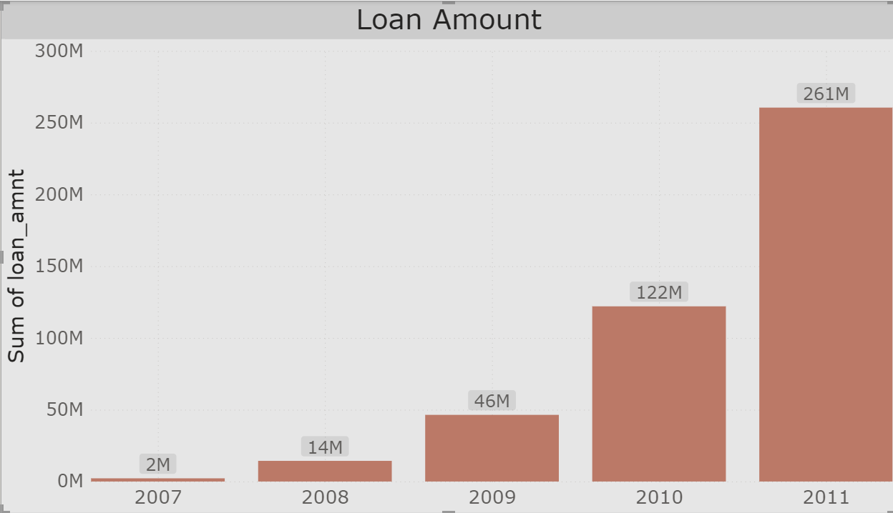
Year wise Loan Amount
Loan amount is gradually increasing from 2007 to 2011.
Predicting the future for a drastic increase in sum of Loan amount.
We observe a high increase of Loan amount between 2010 to 2011.
Expecting to reach at least 500M by 2012 and by 2015 we can reach to 1 B.

Slide 5
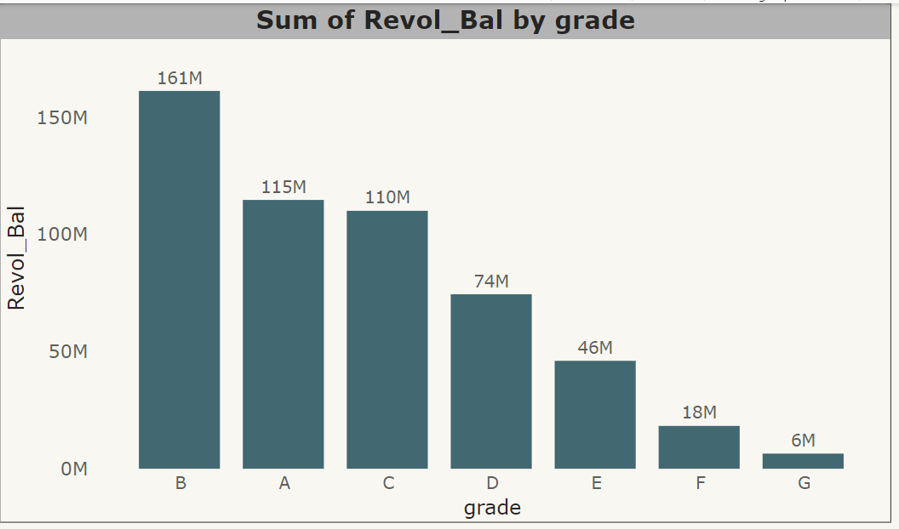
Grade wise Revol_Bal
Grade B has the highest Revol_Bal for all the Years from 2007 to 2011.
Lowest is Grade C of 6M .
Each Grade is divided into 5 Sub Grades and each has different Revol_Bal for different Years.
Average among this would be Grade D.

Slide 6
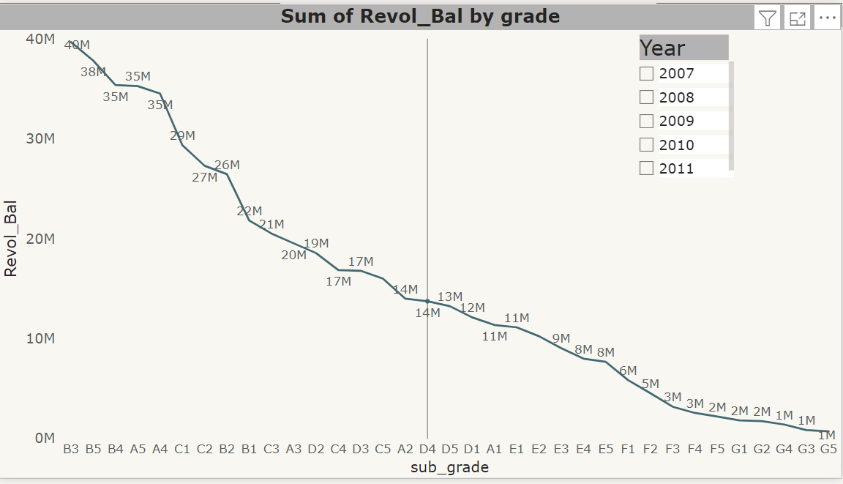
SUB GRADE wise Revol_Bal
B3 Sub grade as the highest Revol_Bal when compared to all other sub grades.
G5 has the lowest Revol_Bal.
Average among these would be Grade D.
The sum of Revol_Bal is fluctuating between high to low for all the Grades.
Predicting to have high Revol_Bal for Grade B in future And A might beat B in future.
When Compared to all the year 2011 has a highest profit.

Slide 7
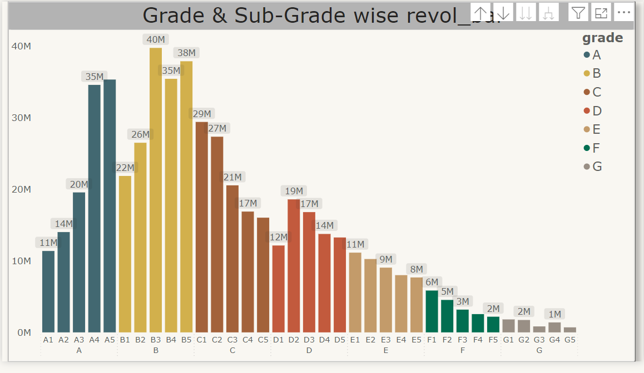
GRADE & Sub grade wise Revol_Bal
Grade B and Sub Grade B3 is having the highest Revol_Bal.
G3 and G5 is having low of less than a Million for all the Years.
We can expect Grade a and B to gain profit in the Future.

Slide 8
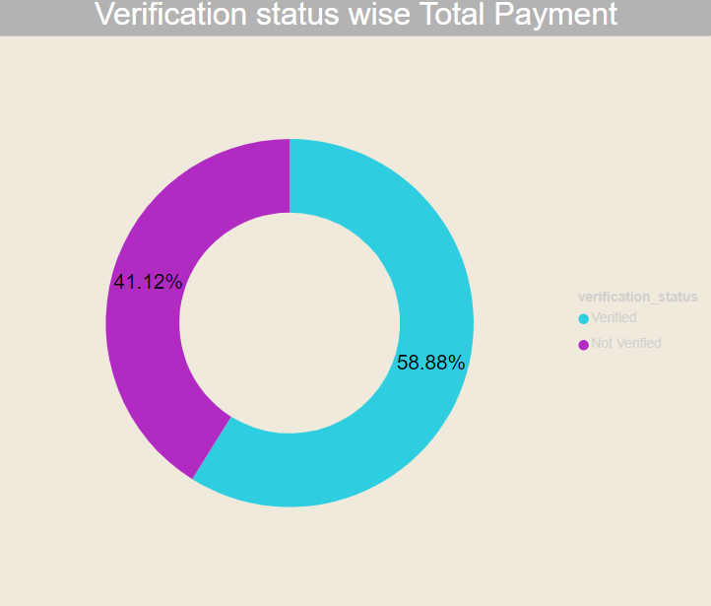
Total Payment for Verified Status Vs Total Payment for Non Verified Status
* This kpi shows the difference between total payment for verified and non-verified status
*Here we find out the relation between loan amount taken by customers and issue date , To show verified customers contribution for total payments.
*The analysis reveals that verified status is more than non verified status.

Slide 9
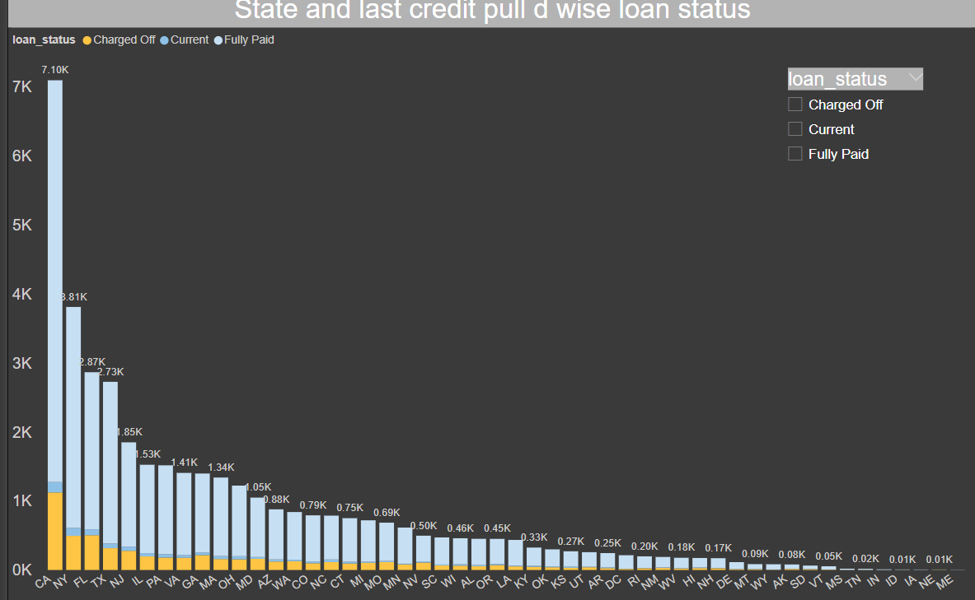
State wise and last_credit_pull_d wise loan status
*Fully paid had the highest total count of loan _ status at 32,950,followed by charged off at 5627 and current at 1140
*Reveals regional variations in loan performance and delinquency rates.
*Guides risk assessment and portfolio management strategies based on geographic factors.

Slide 10
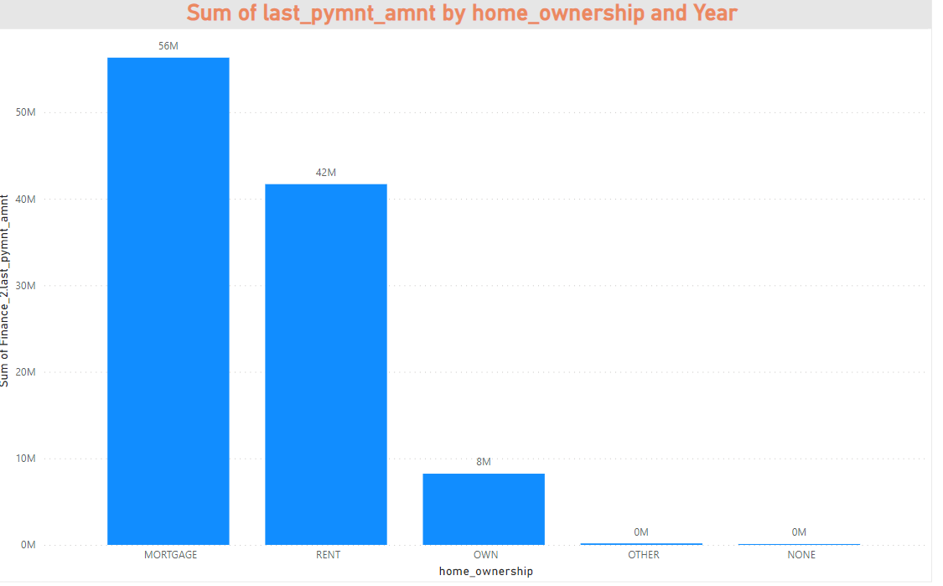
Home ownership Vs last payment date stats
*Indicates the stability and financial responsibility of borrowers.
*Helps assess the likelihood of default based on housing tenure.
*Guides underwriting decisions and risk assessment for different types of borrowers.

Slide 11
conclusion
On the basis of various techniques applied for the Finanacial analysis of bank loan we can arrive to the conclusion that the financial position and overall performance of bank is satisfactory and loan amount and the customers of bank has increased over the period of time and bank has maintaining the profitability position.
This analysis provide valuable information to a wide range of stakeholders from banks and barrowers to investors and customers .

